Slide 1

Computer Operating Systems BLG 312E Week-8
Prof. Dr. Kemal Bıçakcı

Slide 2
Review of Last Week

Slide 3
Review Question
Which one of these is not one of the programming errors made while using thread API?
a) Not initializing locks and condition variables
b) Not checking return codes
c) Allocating memory for local variables returned by threads on Stack.
d) Using condition variables to signal between threads

Slide 4
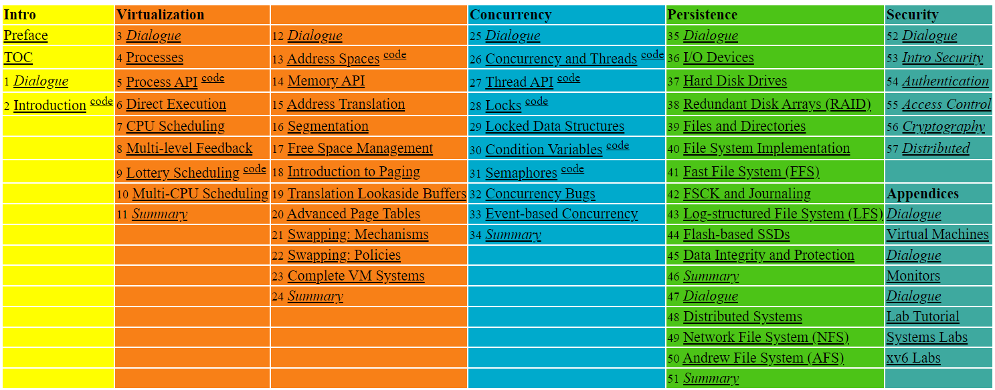

Slide 5
29. Lock-based Concurrent Data Structures
Operating System: Three Easy Pieces

Slide 6
Lock-based Concurrent Data structure
Adding locks to a data structure makes the structure thread safe.
How locks are added determines both the correctness and performance of the data structure.

Slide 7
Example: A Counter without Locks
Simple non-concurrent counter:
1 typedef struct __counter_t {
2 int value;
3 } counter_t;
4
5 void init(counter_t *c) {
6 c->value = 0;
7 }
8
9 void increment(counter_t *c) {
10 c->value++;
11 }
12
13 void decrement(counter_t *c) {
14 c->value--;
15 }
16
17 int get(counter_t *c) {
18 return c->value;
19 }

Slide 8
Example: Concurrent Counters with Locks
How can we make it thread safe?: Add a single lock.
The lock is acquired when calling a routine that manipulates the data structure.
1 typedef struct __counter_t {
2 int value;
3 pthread_lock_t lock;
4 } counter_t;
5
6 void init(counter_t *c) {
7 c->value = 0;
8 Pthread_mutex_init(&c->lock, NULL);
9 }
10
11 void increment(counter_t *c) {
12 Pthread_mutex_lock(&c->lock);
13 c->value++;
14 Pthread_mutex_unlock(&c->lock);
15 }
16

Slide 9
Example: Concurrent Counters with Locks (Cont.)
(Cont.)
17 void decrement(counter_t *c) {
18 Pthread_mutex_lock(&c->lock);
19 c->value--;
20 Pthread_mutex_unlock(&c->lock);
21 }
22
23 int get(counter_t *c) {
24 Pthread_mutex_lock(&c->lock);
25 int rc = c->value;
26 Pthread_mutex_unlock(&c->lock);
27 return rc;
28 }

Slide 10
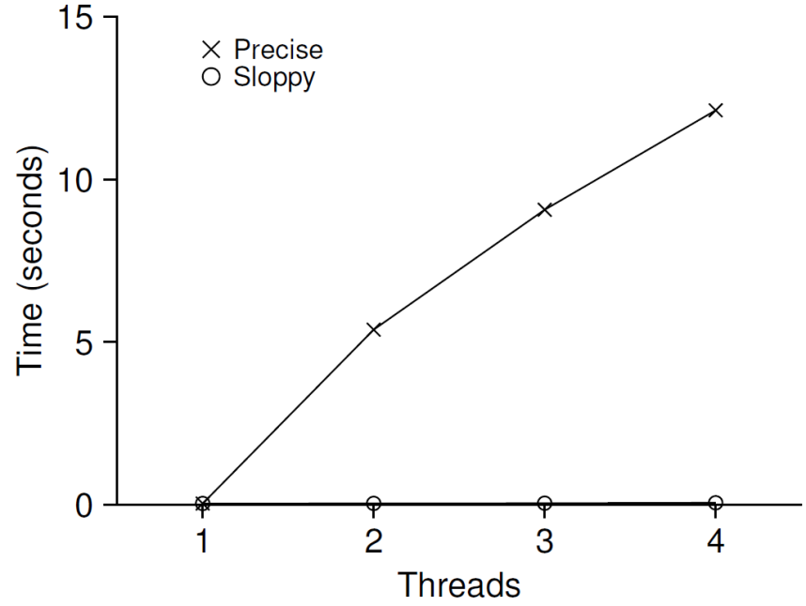
The performance costs of the simple approach
Each thread updates a single shared counter.
Each thread updates the counter one million times.
iMac with four Intel 2.7GHz i5 CPUs.
Performance of
Traditional vs. Sloppy Counters
(Threshold of Sloppy, S, is set to 1024)
Synchronized counter scales poorly.

Slide 11
Scalable counter: Does it really matter?

Slide 12
Perfect Scaling
Even though more work is done, it is done in parallel.
The time taken to complete the task is not increased.

Slide 13
Sloppy counter
The sloppy counter works by representing a single logical counter via numerous local physical counters, one per CPU core AND a single global counter.
There are locks:
One for each local counter and one for the global counter
Example: on a machine with four CPUs
Four local counters
One global counter

Slide 14
The basic idea of sloppy counting
When a thread running on a core wishes to increment the counter:
It increments its local counter.
Each CPU has its own local counter:
Threads across CPUs can update local counters without contention.
Thus counter updates are scalable.
The local values are periodically transferred to the global counter.
Acquire the global lock
Increment the value of global counter by the local counter’s value
The local counter is reset to zero
Release the global lock

Slide 15
The basic idea of sloppy counting (Cont.)
How often the local-to-global transfer occurs is determined by a threshold, S (sloppiness).
The smaller S:
The more the counter behaves like the non-scalable counter.
The bigger S:
The more scalable the counter.
The further off the global value might be from the actual count.

Slide 16


Sloppy counter example
Tracing the Sloppy Counters
The threshold S is set to 5.
There are threads on each of four CPUs
Each thread updates their local counters $L_{1}$… $L_{4}$ $L_{5}$.
Time | $$L_{1}$$ | $$L_{2}$$ | $$L_{3}$$ | $$L_{4}$$ | G
0 | 0 | 0 | 0 | 0 | 0
1 | 0 | 0 | 1 | 1 | 0
2 | 1 | 0 | 2 | 1 | 0
3 | 2 | 0 | 3 | 1 | 0
4 | 3 | 0 | 3 | 2 | 0
5 | 4 | 1 | 3 | 3 | 0
6 | 5 → 0 | 1 | 3 | 4 | 5 (from $L_{1}$)
7 | 0 | 2 | 4 | 5 → 0 | 10 (from $L_{4}$)

Slide 17
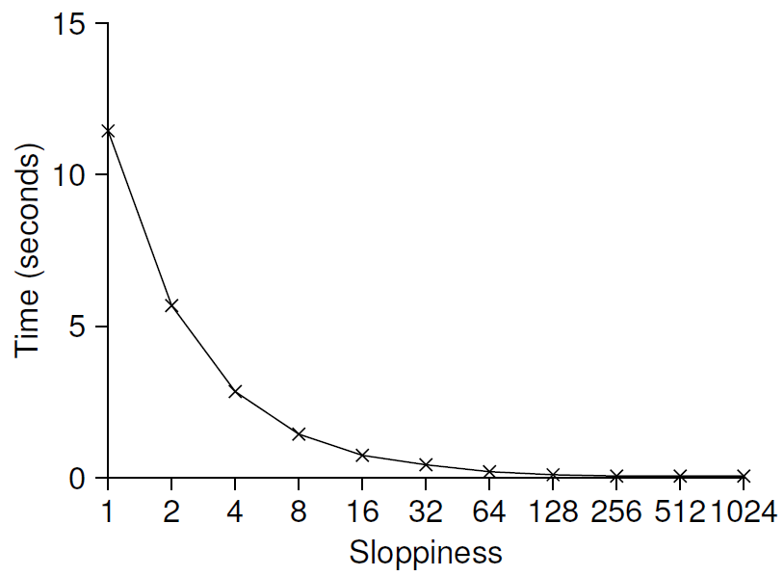
Importance of the threshold value S
Each four threads increments a counter 1 million times on four CPUs.
Low S → Performance is poor, the global count is always quire accurate.
High S → Performance is excellent, the global count lags.
Scaling Sloppy Counters

Slide 18
Sloppy Counter Implementation
1 typedef struct __counter_t {
2 int global; // global count
3 pthread_mutex_t glock; // global lock
4 int local[NUMCPUS]; // local count (per cpu)
5 pthread_mutex_t llock[NUMCPUS]; // ... and locks
6 int threshold; // update frequency
7 } counter_t;
8
9 // init: record threshold, init locks, init values
10 // of all local counts and global count
11 void init(counter_t *c, int threshold) {
12 c->threshold = threshold;
13
14 c->global = 0;
15 pthread_mutex_init(&c->glock, NULL);
16
17 int i;
18 for (i = 0; i < NUMCPUS; i++) {
19 c->local[i] = 0;
20 pthread_mutex_init(&c->llock[i], NULL);
21 }
22 }
23

Slide 19
Sloppy Counter Implementation (Cont.)
(Cont.)
24 // update: usually, just grab local lock and update local amount
25 // once local count has risen by ’threshold’, grab global
26 // lock and transfer local values to it
27 void update(counter_t *c, int threadID, int amt) {
28 pthread_mutex_lock(&c->llock[threadID]);
29 c->local[threadID] += amt; // assumes amt > 0
30 if (c->local[threadID] >= c->threshold) { // transfer to global
31 pthread_mutex_lock(&c->glock);
32 c->global += c->local[threadID];
33 pthread_mutex_unlock(&c->glock);
34 c->local[threadID] = 0;
35 }
36 pthread_mutex_unlock(&c->llock[threadID]);
37 }
38
39 // get: just return global amount (which may not be perfect)
40 int get(counter_t *c) {
41 pthread_mutex_lock(&c->glock);
42 int val = c->global;
43 pthread_mutex_unlock(&c->glock);
44 return val; // only approximate!
45 }

Slide 20
Concurrent Linked Lists
1 // basic node structure
2 typedef struct __node_t {
3 int key;
4 struct __node_t *next;
5 } node_t;
6
7 // basic list structure (one used per list)
8 typedef struct __list_t {
9 node_t *head;
10 pthread_mutex_t lock;
11 } list_t;
12
13 void List_Init(list_t *L) {
14 L->head = NULL;
15 pthread_mutex_init(&L->lock, NULL);
16 }
17
(Cont.)

Slide 21
Concurrent Linked Lists
(Cont.)
18 int List_Insert(list_t *L, int key) {
19 pthread_mutex_lock(&L->lock);
20 node_t *new = malloc(sizeof(node_t));
21 if (new == NULL) {
22 perror("malloc");
23 pthread_mutex_unlock(&L->lock);
24 return -1; // fail
26 new->key = key;
27 new->next = L->head;
28 L->head = new;
29 pthread_mutex_unlock(&L->lock);
30 return 0; // success
31 }
(Cont.)

Slide 22
Concurrent Linked Lists (Cont.)
(Cont.)
32
32 int List_Lookup(list_t *L, int key) {
33 pthread_mutex_lock(&L->lock);
34 node_t *curr = L->head;
35 while (curr) {
36 if (curr->key == key) {
37 pthread_mutex_unlock(&L->lock);
38 return 0; // success
39 }
40 curr = curr->next;
41 }
42 pthread_mutex_unlock(&L->lock);
43 return -1; // failure
44 }

Slide 23
Concurrent Linked Lists (Cont.)
The code acquires a lock in the insert routine upon entry.
The code releases the lock upon exit.
If malloc() happens to fail, the code must also release the lock before failing the insert.
This kind of exceptional control flow has been shown to be quite error prone.
Solution: The lock and release only surround the actual critical section in the insert code

Slide 24
Concurrent Linked List: Rewritten
1 void List_Init(list_t *L) {
2 L->head = NULL;
3 pthread_mutex_init(&L->lock, NULL);
4 }
5
6 void List_Insert(list_t *L, int key) {
7 // synchronization not needed
8 node_t *new = malloc(sizeof(node_t));
9 if (new == NULL) {
10 perror("malloc");
11 return;
12 }
13 new->key = key;
14
15 // just lock critical section
16 pthread_mutex_lock(&L->lock);
17 new->next = L->head;
18 L->head = new;
19 pthread_mutex_unlock(&L->lock);
20 }
21

Slide 25
Concurrent Linked List: Rewritten (Cont.)
(Cont.)
22 int List_Lookup(list_t *L, int key) {
23 int rv = -1;
24 pthread_mutex_lock(&L->lock);
25 node_t *curr = L->head;
26 while (curr) {
27 if (curr->key == key) {
28 rv = 0;
29 break;
30 }
31 curr = curr->next;
32 }
33 pthread_mutex_unlock(&L->lock);
34 return rv; // now both success and failure
35 }

Slide 26
Scaling Linked List
Hand-over-hand locking (lock coupling)
Add a lock per node of the list instead of having a single lock for the entire list.
When traversing the list,
First grabs the next node’s lock.
And then releases the current node’s lock.
Enable a high degree of concurrency in list operations.
However, in practice, the overheads of acquiring and releasing locks for each node of a list traversal is prohibitive.

Slide 27
Michael and Scott Concurrent Queues
There are two locks.
One for the head of the queue.
One for the tail.
The goal of these two locks is to enable concurrency of enqueue and dequeue operations.
Add a dummy node
Allocated in the queue initialization code
Enable the separation of head and tail operations

Slide 28
Concurrent Queues (Cont.)
1 typedef struct __node_t {
2 int value;
3 struct __node_t *next;
4 } node_t;
5
6 typedef struct __queue_t {
7 node_t *head;
8 node_t *tail;
9 pthread_mutex_t headLock;
10 pthread_mutex_t tailLock;
11 } queue_t;
12
13 void Queue_Init(queue_t *q) {
14 node_t *tmp = malloc(sizeof(node_t));
15 tmp->next = NULL;
16 q->head = q->tail = tmp;
17 pthread_mutex_init(&q->headLock, NULL);
18 pthread_mutex_init(&q->tailLock, NULL);
19 }
20
(Cont.)

Slide 29
Concurrent Queues (Cont.)
(Cont.)
21 void Queue_Enqueue(queue_t *q, int value) {
22 node_t *tmp = malloc(sizeof(node_t));
assert(tmp != NULL);
24
25 tmp->value = value;
26 tmp->next = NULL;
27
28 pthread_mutex_lock(&q->tailLock);
29 q->tail->next = tmp;
30 q->tail = tmp;
31 pthread_mutex_unlock(&q->tailLock);
32 }
(Cont.)

Slide 30
Concurrent Queues (Cont.)
(Cont.)
33 int Queue_Dequeue(queue_t *q, int *value) {
34 pthread_mutex_lock(&q->headLock);
35 node_t *tmp = q->head;
36 node_t *newHead = tmp->next;
37 if (newHead == NULL) {
38 pthread_mutex_unlock(&q->headLock);
39 return -1; // queue was empty
40 }
41 *value = newHead->value;
42 q->head = newHead;
43 pthread_mutex_unlock(&q->headLock);
44 free(tmp);
45 return 0;
46 }

Slide 31
Concurrent Hash Table
Focus on a simple hash table
The hash table does not resize.
Built using the concurrent lists
It uses a lock per hash bucket each of which is represented by a list.

Slide 32
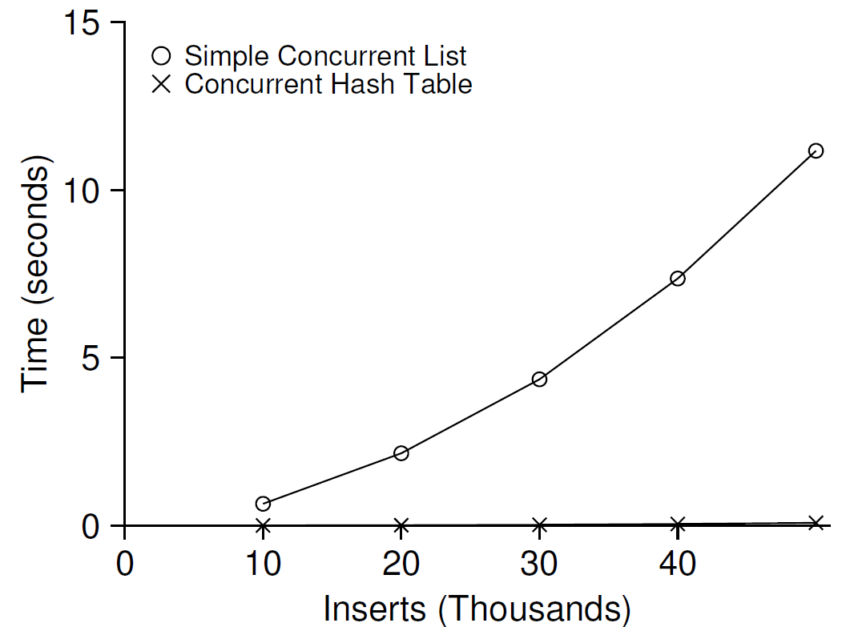
Performance of Concurrent Hash Table
From 10,000 to 50,000 concurrent updates from each of four threads.
iMac with four Intel 2.7GHz i5 CPUs.
The simple concurrent hash table scales magnificently.

Slide 33
Concurrent Hash Table
1 #define BUCKETS (101)
2
3 typedef struct __hash_t {
4 list_t lists[BUCKETS];
5 } hash_t;
6
7 void Hash_Init(hash_t *H) {
8 int i;
9 for (i = 0; i < BUCKETS; i++) {
10 List_Init(&H->lists[i]);
11 }
12 }
13
14 int Hash_Insert(hash_t *H, int key) {
15 int bucket = key % BUCKETS;
16 return List_Insert(&H->lists[bucket], key);
17 }
18
19 int Hash_Lookup(hash_t *H, int key) {
20 int bucket = key % BUCKETS;
21 return List_Lookup(&H->lists[bucket], key);
22 }

Slide 34
30. Condition Variables
Operating System: Three Easy Pieces

Slide 35
Condition Variables
There are many cases where a thread wishes to check whether a condition is true before continuing its execution.
Example:
A parent thread might wish to check whether a child thread has completed.
This is often called a join().

Slide 36
Condition Variables (Cont.)
A Parent Waiting For Its Child
1 void *child(void *arg) {
2 printf("child\n");
3 // XXX how to indicate we are done?
4 return NULL;
5 }
6
7 int main(int argc, char *argv[]) {
8 printf("parent: begin\n");
9 pthread_t c;
10 Pthread_create(&c, NULL, child, NULL); // create child
11 // XXX how to wait for child?
12 printf("parent: end\n");
13 return 0;
14 }
What we would like to see here is:
parent: begin
child
parent: end

Slide 37
Parent waiting for child: Spin-based Approach
1 volatile int done = 0;
2
3 void *child(void *arg) {
4 printf("child\n");
5 done = 1;
6 return NULL;
7 }
8
9 int main(int argc, char *argv[]) {
10 printf("parent: begin\n");
11 pthread_t c;
12 Pthread_create(&c, NULL, child, NULL); // create child
13 while (done == 0)
14 ; // spin
15 printf("parent: end\n");
16 return 0;
17 }
This is hugely inefficient as the parent spins and wastes CPU time.

Slide 38
How to wait for a condition
Condition variable
Waiting on the condition
An explicit queue that threads can put themselves on when some state of execution is not as desired.
Signaling on the condition
Some other thread, when it changes said state, can wake one of those waiting threads and allow them to continue.

Slide 39
Definition and Routines
Declare condition variable
Proper initialization is required.
Operation (the POSIX calls)
The wait() call takes a mutex as a parameter.
The wait() call release the lock and put the calling thread to sleep.
When the thread wakes up, it must re-acquire the lock.
pthread cond t c;
pthread_cond_wait(pthread_cond_t *c, pthread_mutex_t *m); // wait()
pthread_cond_signal(pthread_cond_t *c); // signal()

Slide 40
Parent waiting for Child: Use a condition variable
1 int done = 0;
2 pthread_mutex_t m = PTHREAD_MUTEX_INITIALIZER;
3 pthread_cond_t c = PTHREAD_COND_INITIALIZER;
4
5 void thr_exit() {
6 Pthread_mutex_lock(&m);
7 done = 1;
8 Pthread_cond_signal(&c);
9 Pthread_mutex_unlock(&m);
10 }
11
12 void *child(void *arg) {
13 printf("child\n");
14 thr_exit();
15 return NULL;
16 }
17
18 void thr_join() {
19 Pthread_mutex_lock(&m);
20 while (done == 0)
21 Pthread_cond_wait(&c, &m);
22 Pthread_mutex_unlock(&m);
23 }
24

Slide 41
Parent waiting for Child: Use a condition variable
(cont.)
25 int main(int argc, char *argv[]) {
26 printf("parent: begin\n");
27 pthread_t p;
28 Pthread_create(&p, NULL, child, NULL);
29 thr_join();
30 printf("parent: end\n");
31 return 0;
32 }

Slide 42
Parent waiting for Child: Use a condition variable
Parent:
Create the child thread and continues running itself.
Call into thr_join() to wait for the child thread to complete.
Acquire the lock
Check if the child is done
Put itself to sleep by calling wait()
Release the lock
Child:
Print the message “child”
Call thr_exit() to wake the parent thread
Grab the lock
Set the state variable done
Signal the parent thus waking it.

Slide 43
The importance of the state variable done
1 void thr_exit() {
2 Pthread_mutex_lock(&m);
3 Pthread_cond_signal(&c);
4 Pthread_mutex_unlock(&m);
5 }
6
7 void thr_join() {
8 Pthread_mutex_lock(&m);
9 Pthread_cond_wait(&c, &m);
10 Pthread_mutex_unlock(&m);
11 }
Imagine the case where the child runs immediately.
The child will signal, but there is no thread asleep on the condition.
When the parent runs, it will call wait and be stuck.
No thread will ever wake it.
thr_exit() and thr_join() without variable done

Slide 44
Another poor implementation
1 void thr_exit() {
2 done = 1;
3 Pthread_cond_signal(&c);
4 }
5
6 void thr_join() {
7 if (done == 0)
8 Pthread_cond_wait(&c);
9 }
The issue here is a subtle race condition.
The parent calls thr_join().
The parent checks the value of done.
It will see that it is 0 and try to go to sleep.
Just before it calls wait to go to sleep, the parent is interrupted and the child runs.
The child changes the state variable done to 1 and signals.
But no thread is waiting and thus no thread is woken.
When the parent runs again, it sleeps forever.

Slide 45
The Producer / Consumer (Bounded Buffer) Problem
Producer
Produce data items
Wish to place data items in a buffer
Consumer
Grab data items out of the buffer
Consume them in some way
Example: Multi-threaded web server
A producer puts HTTP requests in to a work queue
Consumer threads take requests out of this queue and process them

Slide 46
Bounded Buffer
A bounded buffer is used when you pipe the output of one program into another.
Example: grep foo file.txt | wc –l
The grep process is the producer.
The wc process is the consumer.
Between them is an in-kernel bounded buffer.
Bounded buffer is a shared resource → Synchronized access is required.

Slide 47
The Put and Get Routines (Version 1)
1 int buffer;
2 int count = 0; // initially, empty
3
4 void put(int value) {
5 assert(count == 0);
6 count = 1;
7 buffer = value;
8 }
9
10 int get() {
11 assert(count == 1);
12 count = 0;
13 return buffer;
14 }
Only put data into the buffer when count is zero.
i.e., when the buffer is empty.
Only get data from the buffer when count is one.
i.e., when the buffer is full.

Slide 48
Producer/Consumer Threads (Version 1)
1 void *producer(void *arg) {
2 int i;
3 int loops = (int) arg;
4 for (i = 0; i < loops; i++) {
5 put(i);
6 }
7 }
8
9 void *consumer(void *arg) {
10 int i;
11 while (1) {
12 int tmp = get();
13 printf("%d\n", tmp);
14 }
15 }
Producer puts an integer into the shared buffer loops number of times.
Consumer gets the data out of that shared buffer.

Slide 49
Producer/Consumer: Single CV and If Statement
A single condition variable cond and associated lock mutex
1 cond_t cond;
2 mutex_t mutex;
3
4 void *producer(void *arg) {
5 int i;
6 for (i = 0; i < loops; i++) {
7 Pthread_mutex_lock(&mutex); // p1
8 if (count == 1) // p2
9 Pthread_cond_wait(&cond, &mutex); // p3
10 put(i); // p4
11 Pthread_cond_signal(&cond); // p5
12 Pthread_mutex_unlock(&mutex); // p6
13 }
14 }
15
16 void *consumer(void *arg) {
17 int i;
18 for (i = 0; i < loops; i++) {
19 Pthread_mutex_lock(&mutex); // c1

Slide 50
Producer/Consumer: Single CV and If Statement
20 if (count == 0) // c2
21 Pthread_cond_wait(&cond, &mutex); // c3
22 int tmp = get(); // c4
23 Pthread_cond_signal(&cond); // c5
24 Pthread_mutex_unlock(&mutex); // c6
25 printf("%d\n", tmp);
26 }
27 }
p1-p3: A producer waits for the buffer to be empty.
c1-c3: A consumer waits for the buffer to be full.
With just a single producer and a single consumer, the code works.
What if we have more than one of producer and consumer?

Slide 51
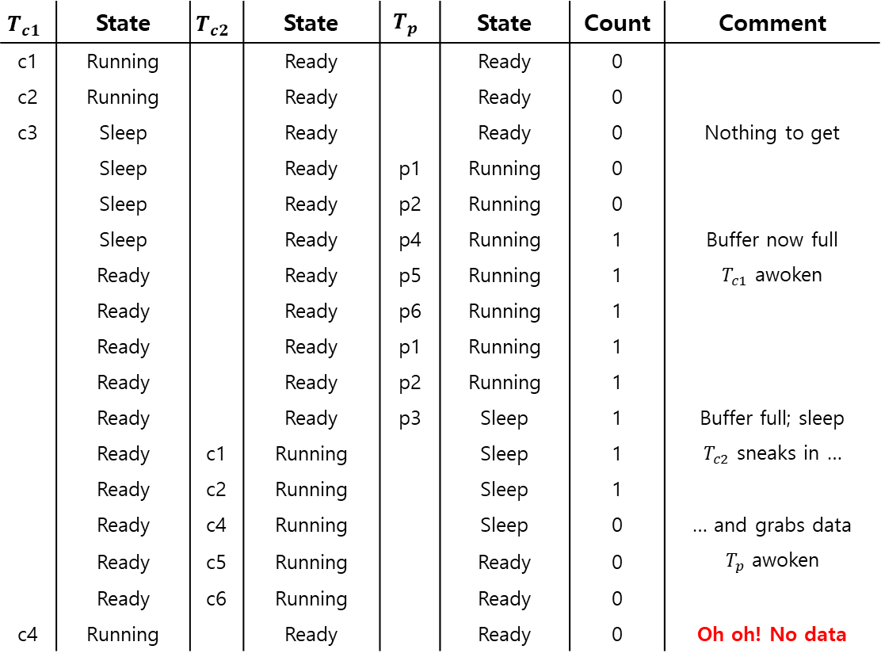
Thread Trace: Broken Solution (Version 1)
$$T_{c1}$$ | State | $$T_{c2}$$ | State | $$T_{p}$$ | State | Count | Comment
c1 | Running |  | Ready |  | Ready | 0
c2 | Running |  | Ready |  | Ready | 0
c3 | Sleep |  | Ready |  | Ready | 0 | Nothing to get
 | Sleep |  | Ready | p1 | Running | 0
 | Sleep |  | Ready | p2 | Running | 0
 | Sleep |  | Ready | p4 | Running | 1 | Buffer now full
 | Ready |  | Ready | p5 | Running | 1 | $T_{c1}$ awoken
 | Ready |  | Ready | p6 | Running | 1
 | Ready |  | Ready | p1 | Running | 1
 | Ready |  | Ready | p2 | Running | 1
 | Ready |  | Ready | p3 | Sleep | 1 | Buffer full; sleep
 | Ready | c1 | Running |  | Sleep | 1 | $T_{c2}$ sneaks in …
 | Ready | c2 | Running |  | Sleep | 1
 | Ready | c4 | Running |  | Sleep | 0 | … and grabs data
 | Ready | c5 | Running |  | Ready | 0 | $T_{p}$ awoken
 | Ready | c6 | Running |  | Ready | 0
c4 | Running |  | Ready |  | Ready | 0 | Oh oh! No data

Slide 52

Thread Trace: Broken Solution (Version 1)
The problem arises for a simple reason:
After the producer woke $T_{c1}$, but before $T_{c1}$ ever ran, the state of the bounded buffer changed by $T_{c2}$.
There is no guarantee that when the woken thread runs, the state will still be as desired → Mesa semantics.
Virtually every system ever built employs Mesa semantics.
Hoare semantics provides a stronger guarantee that the woken thread will run immediately upon being woken.

Slide 53

Producer/Consumer: Single CV and While
Consumer $T_{c1}$ wakes up and re-checks the state of the shared variable.
If the buffer is empty, the consumer simply goes back to sleep.
1 cond_t cond;
2 mutex_t mutex;
3
4 void *producer(void *arg) {
5 int i;
6 for (i = 0; i < loops; i++) {
7 Pthread_mutex_lock(&mutex); // p1
8 while (count == 1) // p2
9 Pthread_cond_wait(&cond, &mutex); // p3
10 put(i); // p4
11 Pthread_cond_signal(&cond); // p5
12 Pthread_mutex_unlock(&mutex); // p6
13 }
14 }
15

Slide 54
Producer/Consumer: Single CV and While
(Cont.)
16 void *consumer(void *arg) {
17 int i;
18 for (i = 0; i < loops; i++) {
19 Pthread_mutex_lock(&mutex); // c1
20 while (count == 0) // c2
21 Pthread_cond_wait(&cond, &mutex); // c3
22 int tmp = get(); // c4
23 Pthread_cond_signal(&cond); // c5
24 Pthread_mutex_unlock(&mutex); // c6
25 printf("%d\n", tmp);
26 }
27 }
A simple rule to remember with condition variables is to always use while loops.
However, this code still has a bug (next page).

Slide 55
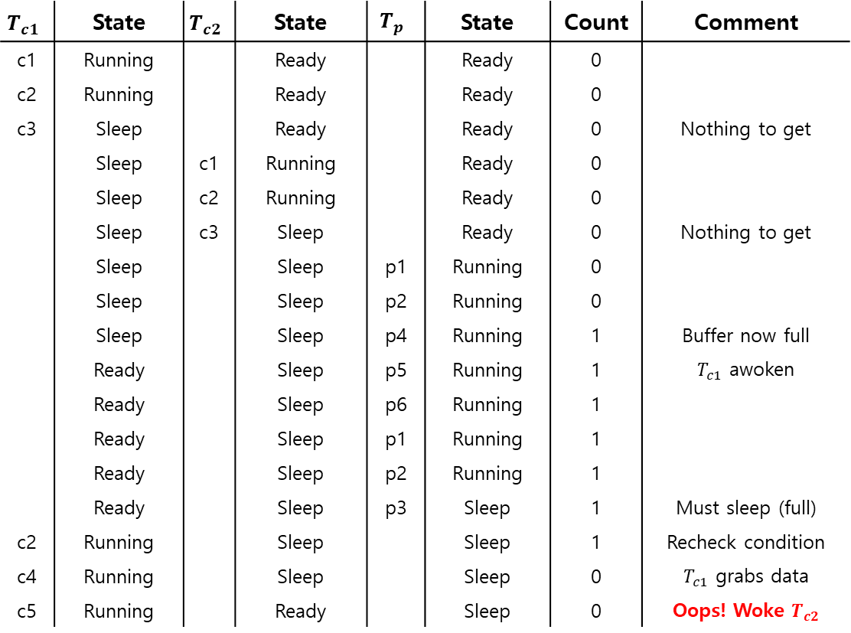
Thread Trace: Broken Solution (Version 2)
$$T_{c1}$$ | State | $$T_{c2}$$ | State | $$T_{p}$$ | State | Count | Comment
c1 | Running |  | Ready |  | Ready | 0
c2 | Running |  | Ready |  | Ready | 0
c3 | Sleep |  | Ready |  | Ready | 0 | Nothing to get
 | Sleep | c1 | Running |  | Ready | 0
 | Sleep | c2 | Running |  | Ready | 0
 | Sleep | c3 | Sleep |  | Ready | 0 | Nothing to get
 | Sleep |  | Sleep | p1 | Running | 0
 | Sleep |  | Sleep | p2 | Running | 0
 | Sleep |  | Sleep | p4 | Running | 1 | Buffer now full
 | Ready |  | Sleep | p5 | Running | 1 | $T_{c1}$ awoken
 | Ready |  | Sleep | p6 | Running | 1
 | Ready |  | Sleep | p1 | Running | 1
 | Ready |  | Sleep | p2 | Running | 1
 | Ready |  | Sleep | p3 | Sleep | 1 | Must sleep (full)
c2 | Running |  | Sleep |  | Sleep | 1 | Recheck condition
c4 | Running |  | Sleep |  | Sleep | 0 | $T_{c1}$ grabs data
c5 | Running |  | Ready |  | Sleep | 0 | Oops! Woke $T_{c2}$

Slide 56
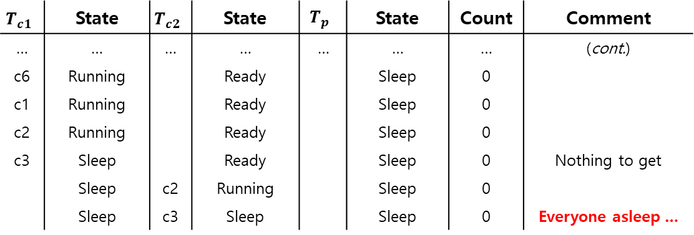
Thread Trace: Broken Solution (Version 2) (Cont.)
A consumer should not wake other consumers, only producers, and vice-versa.
$$T_{c1}$$ | State | $$T_{c2}$$ | State | $$T_{p}$$ | State | Count | Comment
… | … | … | … | … | … | … | (cont.)
c6 | Running |  | Ready |  | Sleep | 0
c1 | Running |  | Ready |  | Sleep | 0
c2 | Running |  | Ready |  | Sleep | 0
c3 | Sleep |  | Ready |  | Sleep | 0 | Nothing to get
 | Sleep | c2 | Running |  | Sleep | 0
 | Sleep | c3 | Sleep |  | Sleep | 0 | Everyone asleep …

Slide 57
The single Buffer Producer/Consumer Solution
Use two condition variables and while
Producer threads wait on the condition empty, and signals fill.
Consumer threads wait on fill and signal empty.
1 cond_t empty, fill;
2 mutex_t mutex;
3
4 void *producer(void *arg) {
5 int i;
6 for (i = 0; i < loops; i++) {
7 Pthread_mutex_lock(&mutex);
8 while (count == 1)
9 Pthread_cond_wait(&empty, &mutex);
10 put(i);
11 Pthread_cond_signal(&fill);
12 Pthread_mutex_unlock(&mutex);
13 }
14 }
15

Slide 58
The single Buffer Producer/Consumer Solution
(Cont.)
16 void *consumer(void *arg) {
17 int i;
18 for (i = 0; i < loops; i++) {
19 Pthread_mutex_lock(&mutex);
20 while (count == 0)
21 Pthread_cond_wait(&fill, &mutex);
22 int tmp = get();
23 Pthread_cond_signal(&empty);
24 Pthread_mutex_unlock(&mutex);
25 printf("%d\n", tmp);
26 }
27 }

Slide 59
The Final Producer/Consumer Solution
More concurrency and efficiency → Add more buffer slots.
Allow concurrent production or consuming to take place.
Reduce context switches.
1 int buffer[MAX];
2 int fill = 0;
3 int use = 0;
4 int count = 0;
5
6 void put(int value) {
7 buffer[fill] = value;
8 fill = (fill + 1) % MAX;
9 count++;
10 }
11
12 int get() {
13 int tmp = buffer[use];
14 use = (use + 1) % MAX;
15 count--;
16 return tmp;
17 }
The Final Put and Get Routines

Slide 60
The Final Producer/Consumer Solution (Cont.)
1 cond_t empty, fill;
2 mutex_t mutex;
3
4 void *producer(void *arg) {
5 int i;
6 for (i = 0; i < loops; i++) {
7 Pthread_mutex_lock(&mutex); // p1
8 while (count == MAX) // p2
9 Pthread_cond_wait(&empty, &mutex); // p3
10 put(i); // p4
11 Pthread_cond_signal(&fill); // p5
12 Pthread_mutex_unlock(&mutex); // p6
13 }
14 }
15
16 void *consumer(void *arg) {
17 int i;
18 for (i = 0; i < loops; i++) {
19 Pthread_mutex_lock(&mutex); // c1
20 while (count == 0) // c2
21 Pthread_cond_wait(&fill, &mutex); // c3
22 int tmp = get(); // c4

Slide 61
The Final Producer/Consumer Solution (Cont.)
p2: A producer only sleeps if all buffers are currently filled.
c2: A consumer only sleeps if all buffers are currently empty.
(Cont.)
23 Pthread_cond_signal(&empty); // c5
24 Pthread_mutex_unlock(&mutex); // c6
25 printf("%d\n", tmp);
26 }
27 }
The Final Working Solution (Cont.)

Slide 62
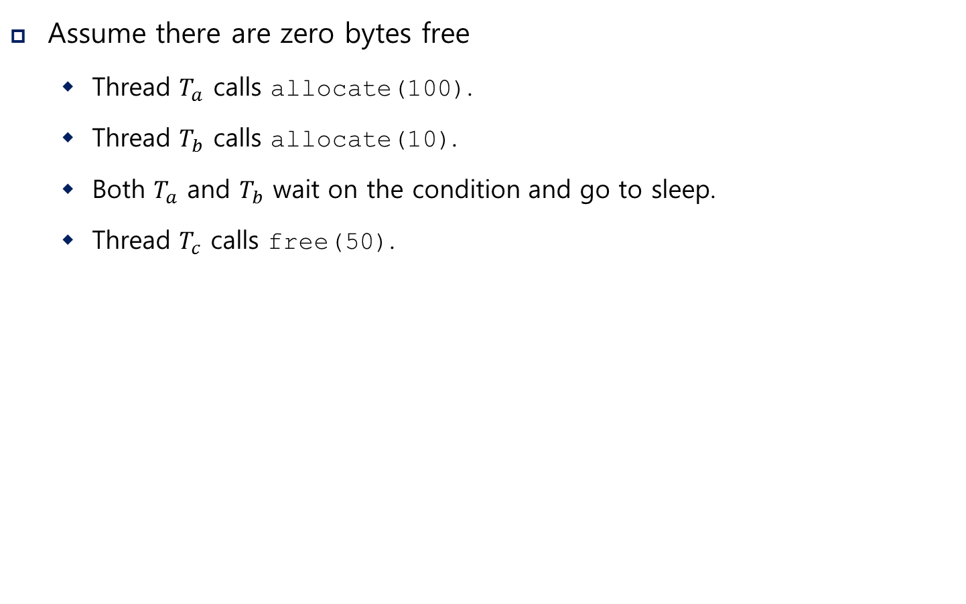
Covering Conditions
Assume there are zero bytes free
Thread $T_{a}$ calls allocate(100).
Thread $T_{b}$ calls allocate(10).
Both $T_{a}$ and $T_{b}$ wait on the condition and go to sleep.
Thread $T_{c}$ calls free(50).
Which waiting thread should be woken up?

Slide 63
Covering Conditions (Cont.)
1 // how many bytes of the heap are free?
2 int bytesLeft = MAX_HEAP_SIZE;
3
4 // need lock and condition too
5 cond_t c;
6 mutex_t m;
7
8 void *
9 allocate(int size) {
10 Pthread_mutex_lock(&m);
11 while (bytesLeft < size)
12 Pthread_cond_wait(&c, &m);
13 void *ptr = ...; // get mem from heap
14 bytesLeft -= size;
15 Pthread_mutex_unlock(&m);
16 return ptr;
17 }
18
19 void free(void *ptr, int size) {
20 Pthread_mutex_lock(&m);
21 bytesLeft += size;
22 Pthread_cond_signal(&c); // whom to signal??
23 Pthread_mutex_unlock(&m);
24 }

Slide 64
Covering Conditions (Cont.)
Solution (Suggested by Lampson and Redell)
Replace pthread_cond_signal() with pthread_cond_broadcast()
pthread_cond_broadcast():
Wake up all waiting threads.
Cost: too many threads might be woken.
Threads that shouldn’t be awake will simply wake up, re-check the condition, and then go back to sleep.

Slide 65
31. Semaphore
Operating System: Three Easy Pieces

Slide 66
Semaphore: A definition
An object with an integer value
We can manipulate with two routines; sem_wait() and sem_post().
Initialization
Declare a semaphore s and initialize it to the value 1
The second argument, 0, indicates that the semaphore is shared between threads in the same process.
#include <semaphore.h>
sem_t s;
sem_init(&s, 0, 1); // initialize s to the value 1

Slide 67
Semaphore: Interact with semaphore
sem_wait()
If the value of the semaphore was one or higher when called sem_wait(), return right away.
It will cause the caller to suspend execution waiting for a subsequent post.
When negative, the value of the semaphore is equal to the number of waiting threads.
1 int sem_wait(sem_t *s) {
2 decrement the value of semaphore s by one
3 wait if value of semaphore s is negative
4 }

Slide 68
Semaphore: Interact with semaphore (Cont.)
sem_post()
Simply increments the value of the semaphore.
If there is a thread waiting to be woken, wakes one of them up.
1 int sem_post(sem_t *s) {
2 increment the value of semaphore s by one
3 if there are one or more threads waiting, wake one
4 }

Slide 69
Binary Semaphores (Locks)
What should X be?
1 sem_t m;
2 sem_init(&m, 0, X); // initialize semaphore to X; what should X be?
3
4 sem_wait(&m);
5 //critical section here
6 sem_post(&m);

Slide 70
Binary Semaphores (Locks)
What should X be?
The initial value of X should be 1.
1 sem_t m;
2 sem_init(&m, 0, X); // initialize semaphore to X; what should X be?
3
4 sem_wait(&m);
5 //critical section here
6 sem_post(&m);

Slide 71
Thread Trace: Single Thread Using A Semaphore
Value of Semaphore | Thread 0 | Thread 1
1
1 | call sema_wait()
0 | sem_wait() returns
0 | (crit sect)
0 | call sem_post()
1 | sem_post() returns

Slide 72
Thread Trace: Two Threads Using A Semaphore
Value | Thread 0 | State | Thread 1 | State
1 |  | Running |  | Ready
1 | call sem_wait() | Running |  | Ready
0 | sem_wait() retruns | Running |  | Ready
0 | (crit set: begin) | Running |  | Ready
0 | Interrupt; Switch → T1 | Ready |  | Running
0 |  | Ready | call sem_wait() | Running
-1 |  | Ready | decrement sem | Running
-1 |  | Ready | (sem < 0)→sleep | sleeping
-1 |  | Running | Switch → T0 | sleeping
-1 | (crit sect: end) | Running |  | sleeping
-1 | call sem_post() | Running |  | sleeping
0 | increment sem | Running |  | sleeping
0 | wake(T1) | Running |  | Ready
0 | sem_post() returns | Running |  | Ready
0 | Interrupt; Switch → T1 | Ready |  | Running
0 |  | Ready | sem_wait() retruns | Running
0 |  | Ready | (crit sect) | Running
0 |  | Ready | call sem_post() | Running
1 |  | Ready | sem_post() returns | Running

Slide 73
Semaphores As Condition Variables
1 sem_t s;
2
3 void *
4 child(void *arg) {
5 printf("child\n");
6 sem_post(&s); // signal here: child is done
7 return NULL;
8 }
9
10 int
11 main(int argc, char *argv[]) {
12 sem_init(&s, 0, X); // what should X be?
13 printf("parent: begin\n");
14 pthread_t c;
15 pthread_create(c, NULL, child, NULL);
16 sem_wait(&s); // wait here for child
17 printf("parent: end\n");
18 return 0;
19 }
What should X be?
parent: begin
child
parent: end
A Parent Waiting For Its Child
The execution result

Slide 74
Semaphores As Condition Variables
1 sem_t s;
2
3 void *
4 child(void *arg) {
5 printf("child\n");
6 sem_post(&s); // signal here: child is done
7 return NULL;
8 }
9
10 int
11 main(int argc, char *argv[]) {
12 sem_init(&s, 0, X); // what should X be?
13 printf("parent: begin\n");
14 pthread_t c;
15 pthread_create(c, NULL, child, NULL);
16 sem_wait(&s); // wait here for child
17 printf("parent: end\n");
18 return 0;
19 }
What should X be?
The value of semaphore should be set to is 0.
parent: begin
child
parent: end
A Parent Waiting For Its Child
The execution result

Slide 75
Thread Trace: Parent Waiting For Child (Case 1)
The parent call sem_wait() before the child has called sem_post().
Value | Parent | State | Child | State
0 | Create(Child) | Running | (Child exists; is runnable) | Ready
0 | call sem_wait() | Running |  | Ready
-1 | decrement sem | Running |  | Ready
-1 | (sem < 0)→sleep | sleeping |  | Ready
-1 | Switch→Child | sleeping | child runs | Running
-1 |  | sleeping | call sem_post() | Running
0 |  | sleeping | increment sem | Running
0 |  | Ready | wake(Parent) | Running
0 |  | Ready | sem_post() returns | Running
0 |  | Ready | Interrupt; Switch→Parent | Ready
0 | sem_wait() retruns | Running |  | Ready

Slide 76
Thread Trace: Parent Waiting For Child (Case 2)
The child runs to completion before the parent call sem_wait().
Value | Parent | State | Child | State
0 | Create(Child) | Running | (Child exists; is runnable) | Ready
0 | Interrupt; switch→Child | Ready | child runs | Running
0 |  | Ready | call sem_post() | Running
1 |  | Ready | increment sem | Running
1 |  | Ready | wake(nobody) | Running
1 |  | Ready | sem_post() returns | Running
1 | parent runs | Running | Interrupt; Switch→Parent | Ready
1 | call sem_wait() | Running |  | Ready
0 | decrement sem | Running |  | Ready
0 | (sem<0)→awake | Running |  | Ready
0 | sem_wait() retruns | Running |  | Ready

Slide 77
The Producer/Consumer (Bounded-Buffer) Problem
Producer: put() interface
Wait for a buffer to become empty in order to put data into it.
Consumer: get() interface
Wait for a buffer to become filled before using it.
1 int buffer[MAX];
2 int fill = 0;
3 int use = 0;
4
5 void put(int value) {
6 buffer[fill] = value; // line f1
7 fill = (fill + 1) % MAX; // line f2
8 }
9
10 int get() {
11 int tmp = buffer[use]; // line g1
12 use = (use + 1) % MAX; // line g2
13 return tmp;
14 }

Slide 78
The Producer/Consumer (Bounded-Buffer) Problem
1 sem_t empty;
2 sem_t full;
3
4 void *producer(void *arg) {
5 int i;
6 for (i = 0; i < loops; i++) {
7 sem_wait(&empty); // line P1
8 put(i); // line P2
9 sem_post(&full); // line P3
10 }
11 }
12
13 void *consumer(void *arg) {
14 int i, tmp = 0;
15 while (tmp != -1) {
16 sem_wait(&full); // line C1
17 tmp = get(); // line C2
18 sem_post(&empty); // line C3
19 printf("%d\n", tmp);
20 }
}
…
First Attempt: Adding the Full and Empty Conditions

Slide 79
The Producer/Consumer (Bounded-Buffer) Problem
Imagine that MAX is greater than 1 .
If there are multiple producers, race condition can happen at line f1.
It means that the old data there is overwritten.
We’ve forgotten here is mutual exclusion.
The filling of a buffer and incrementing of the index into the buffer is a critical section.
int main(int argc, char *argv[]) {
// …
sem_init(&empty, 0, MAX); // MAX buffers are empty to begin with…
sem_init(&full, 0, 0); // … and 0 are full
// …
}
First Attempt: Adding the Full and Empty Conditions (Cont.)

Slide 80
A Solution: Adding Mutual Exclusion
1 sem_t empty;
2 sem_t full;
3 sem_t mutex;
4
5 void *producer(void *arg) {
6 int i;
7 for (i = 0; i < loops; i++) {
8 sem_wait(&mutex); // line p0 (NEW LINE)
9 sem_wait(&empty); // line p1
10 put(i); // line p2
11 sem_post(&full); // line p3
12 sem_post(&mutex); // line p4 (NEW LINE)
13 }
14 }
15
(Cont.)
Adding Mutual Exclusion (Incorrectly)

Slide 81
A Solution: Adding Mutual Exclusion
(Cont.)
16 void *consumer(void *arg) {
17 int i;
18 for (i = 0; i < loops; i++) {
19 sem_wait(&mutex); // line c0 (NEW LINE)
20 sem_wait(&full); // line c1
int tmp = get(); // line c2
22 sem_post(&empty); // line c3
23 sem_post(&mutex); // line c4 (NEW LINE)
24 printf("%d\n", tmp);
25 }
26 }
Adding Mutual Exclusion (Incorrectly)

Slide 82
A Solution: Adding Mutual Exclusion (Cont.)
Imagine two thread: one producer and one consumer.
The consumer acquire the mutex (line c0).
The consumer calls sem_wait() on the full semaphore (line c1).
The consumer is blocked and yield the CPU.
The consumer still holds the mutex!
The producer calls sem_wait() on the binary mutex semaphore (line p0).
The producer is now stuck waiting too → a classic deadlock.

Slide 83
Finally, A Working Solution
1 sem_t empty;
2 sem_t full;
3 sem_t mutex;
4
5 void *producer(void *arg) {
6 int i;
7 for (i = 0; i < loops; i++) {
8 sem_wait(&empty); // line p1
9 sem_wait(&mutex); // line p1.5 (MOVED MUTEX HERE…)
10 put(i); // line p2
11 sem_post(&mutex); // line p2.5 (… AND HERE)
12 sem_post(&full); // line p3
13 }
14 }
15
(Cont.)
Adding Mutual Exclusion (Correctly)

Slide 84
Finally, A Working Solution
(Cont.)
16 void *consumer(void *arg) {
17 int i;
18 for (i = 0; i < loops; i++) {
19 sem_wait(&full); // line c1
20 sem_wait(&mutex); // line c1.5 (MOVED MUTEX HERE…)
21 int tmp = get(); // line c2
22 sem_post(&mutex); // line c2.5 (… AND HERE)
sem_post(&empty); // line c3
printf(“%d\n”, tmp);
}
}
int main(int argc, char *argv[]) {
// …
sem_init(&empty, 0, MAX); // MAX buffers are empty to begin with …
sem_init(&full, 0, 0); // ... and 0 are full
sem_init(&mutex, 0, 1); // mutex=1 because it is a lock
// …
}
Adding Mutual Exclusion (Correctly)

Slide 85
Reader-Writer Locks
Imagine a number of concurrent list operations, including inserts and simple lookups.
insert:
Change the state of the list
A traditional critical section makes sense.
lookup:
Simply read the data structure.
As long as we can guarantee that no insert is on-going, we can allow many lookups to proceed concurrently.
This special type of lock is known as a reader-write lock.

Slide 86
A Reader-Writer Locks
Only a single writer can acquire the lock.
Once a reader has acquired a read lock, more readers will be allowed to acquire the read lock too.
A writer will have to wait until all readers are finished.
typedef struct _rwlock_t {
sem_t lock; // binary semaphore (basic lock)
sem_t writelock; // used to allow ONE writer or MANY readers
int readers; // count of readers reading in critical section
} rwlock_t;
void rwlock_init(rwlock_t *rw) {
rw->readers = 0;
sem_init(&rw->lock, 0, 1);
sem_init(&rw->writelock, 0, 1);
}
void rwlock_acquire_readlock(rwlock_t *rw) {
sem_wait(&rw->lock);
…

Slide 87
A Reader-Writer Locks (Cont.)
rw->readers++;
if (rw->readers == 1)
sem_wait(&rw->writelock); // first reader acquires writelock
sem_post(&rw->lock);
}
void rwlock_release_readlock(rwlock_t *rw) {
sem_wait(&rw->lock);
rw->readers--;
if (rw->readers == 0)
sem_post(&rw->writelock); // last reader releases writelock
sem_post(&rw->lock);
}
void rwlock_acquire_writelock(rwlock_t *rw) {
sem_wait(&rw->writelock);
}
void rwlock_release_writelock(rwlock_t *rw) {
sem_post(&rw->writelock);
}

Slide 88
A Reader-Writer Locks (Cont.)
The reader-writer locks have fairness problem.
It would be relatively easy for reader to starve writers.
How to prevent more readers from entering the lock once a writer is waiting?

Slide 89
The Dining Philosophers
Assume there are five “philosophers” sitting around a table.
Between each pair of philosophers is a single fork (five total).
The philosophers each have times where they think, and don’t need any forks, and times where they eat.
In order to eat, a philosopher needs two forks, both the one on their left and the one on their right.
The contention for these forks.
P1
f2
f1
P2
P0
f3
f0
P3
P4
f4

Slide 90
The Dining Philosophers (Cont.)
Key challenge:
No deadlock.
No philosopher starves and never gets to eat.
High level of Concurrency.
Philosopher p wishes to refer to the for on their left → call left(p).
Philosopher p wishes to refer to the for on their right → call right(p).
while (1) {
think();
getforks();
eat();
putforks();
}
// helper functions
int left(int p) { return p; }
int right(int p) {
return (p + 1) % 5;
}
Basic loop of each philosopher
Helper functions (Downey’s solutions)

Slide 91
The Dining Philosophers (Cont.)
We need some semaphore, one for each fork: sem_t forks[5].
Deadlock occurs!
If each philosopher happens to grab the fork on their left before any philosopher can grab the fork on their right.
Each will be stuck holding one fork and waiting for another, forever.
void getforks() {
sem_wait(forks[left(p)]);
sem_wait(forks[right(p)]);
}
void putforks() {
sem_post(forks[left(p)]);
sem_post(forks[right(p)]);
}
The getforks()and putforks() Routines (Broken Solution)

Slide 92
A Solution: Breaking The Dependency
Change how forks are acquired.
Let’s assume that philosopher 4 acquire the forks in a different order.
There is no situation where each philosopher grabs one fork and is stuck waiting for another. The cycle of waiting is broken.
void getforks() {
if (p == 4) {
sem_wait(forks[right(p)]);
sem_wait(forks[left(p)]);
} else {
sem_wait(forks[left(p)]);
sem_wait(forks[right(p)]);
}
}

Slide 93
How To Implement Semaphores
Build our own version of semaphores called Zemaphores
typedef struct __Zem_t {
int value;
pthread_cond_t cond;
pthread_mutex_t lock;
} Zem_t;
// only one thread can call this
void Zem_init(Zem_t *s, int value) {
s->value = value;
Cond_init(&s->cond);
Mutex_init(&s->lock);
}
void Zem_wait(Zem_t *s) {
Mutex_lock(&s->lock);
while (s->value <= 0)
Cond_wait(&s->cond, &s->lock);
s->value--;
Mutex_unlock(&s->lock);
}
…

Slide 94
How To Implement Semaphores (Cont.)
void Zem_post(Zem_t *s) {
Mutex_lock(&s->lock);
s->value++;
Cond_signal(&s->cond);
Mutex_unlock(&s->lock);
}
Zemaphore don’t maintain the invariant that the value of the semaphore.
The value never be lower than zero.
This behavior is easier to implement and matches the current Linux implementation.

